Slide 1
WEB CRAWLER AND NLP SYSTEM PRESENTATION
Presented by Imran Yusuf
24 April 2021

Slide 2
AGENDA
01
02
03
PROBLEM & SOLUTION
CODE MANAGEMENT
lIMITATIONS DISCUSSION
Discussion of Project and deliverables
Demonstration of code repository
Limitations of web crawler and NLP system

Slide 3
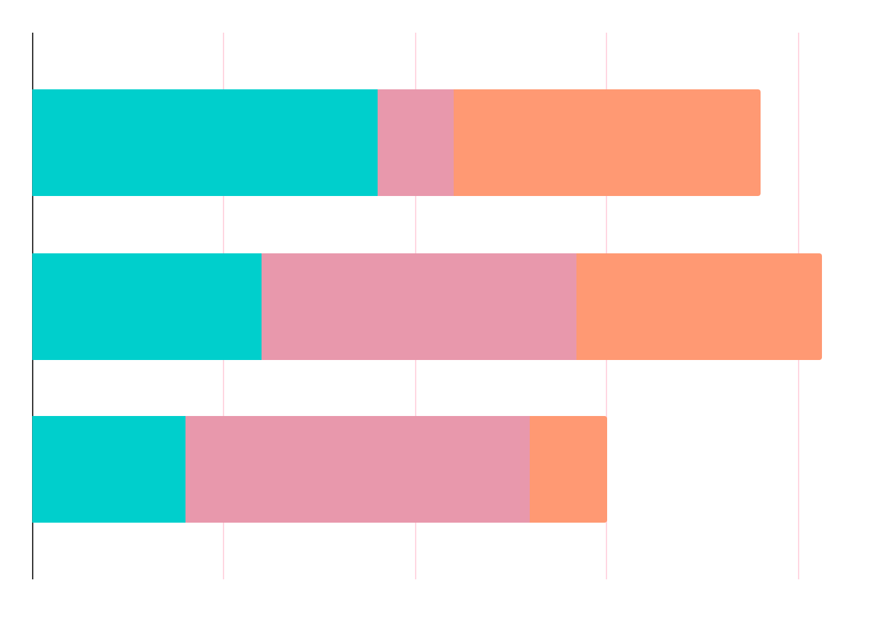
BACKGROUND
Housing
Real Estate Sentiment
Competitive Edge
Australia’s largest asset class
Differs between states and territories
Correlate real estate sentiments to investment decisions

Slide 4
PROBLEM STATEMENT
“Autonomously estimate the relative strengths of the property market across all states and territories in Australia, as a function of time”

Slide 5
WEBSITE SELECTION
WEB CRAWLER
Named Entity Recognition (NER)
Sentiment Analysis
PROPOSED SOLUTION
The onthehouse property news website
Extract title, publication date, body text and place tags from Document Object Model (DOM)
Spacy’s NER model used to detect place entities
Multinomial Naïve Bayes used to predict positive, neutral or negative sentiment

Slide 6
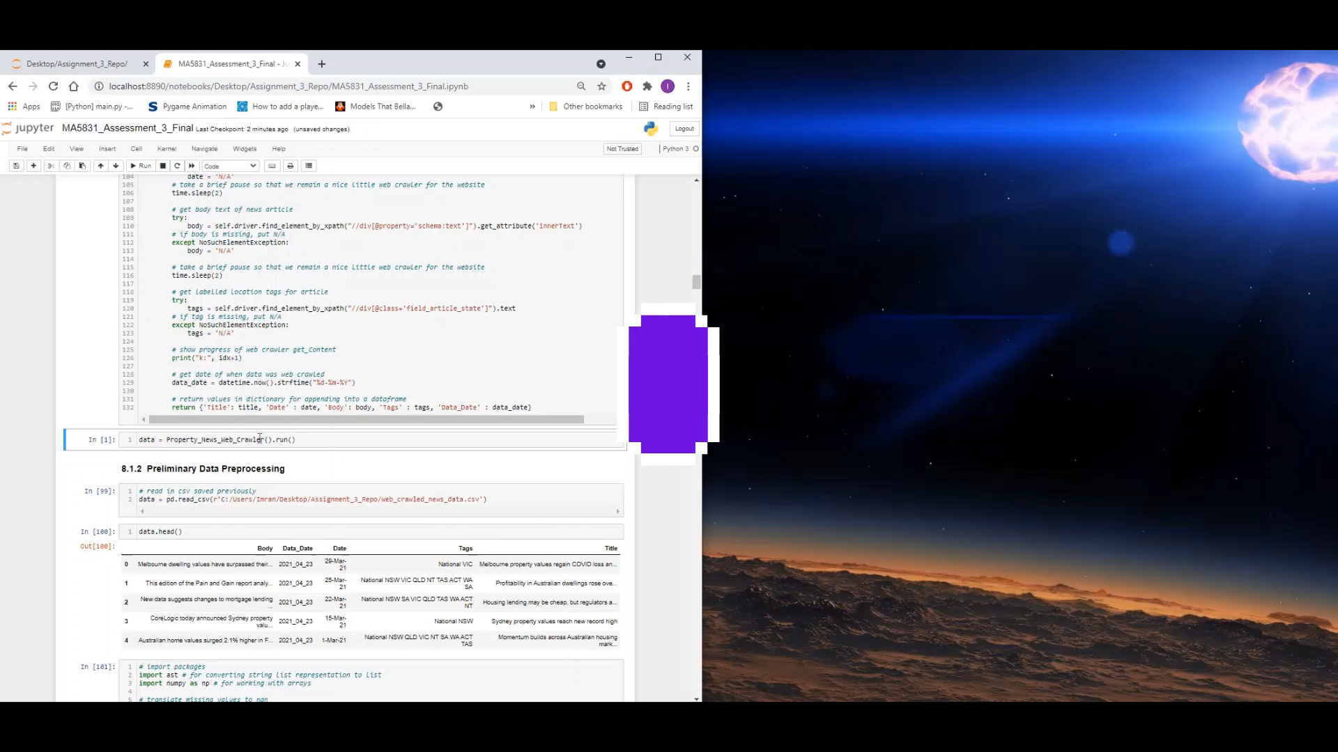
DEMONSTRATION OF WEB CRAWLER

Slide 7
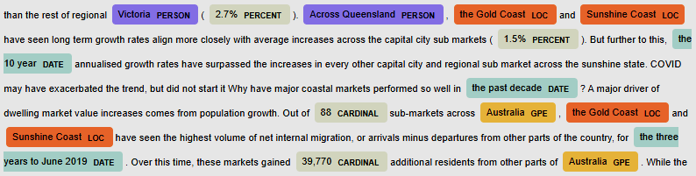
NER RESULTS
The combination of Spacy’s NER model and use of Nominatim was 73% accurate

Slide 8
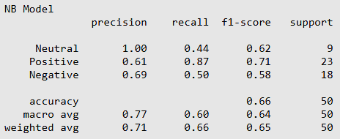
SENTIMENT ANALYSIS RESULTS
The Multinomial Naïve Bayes classifier was 64% accurate

Slide 9
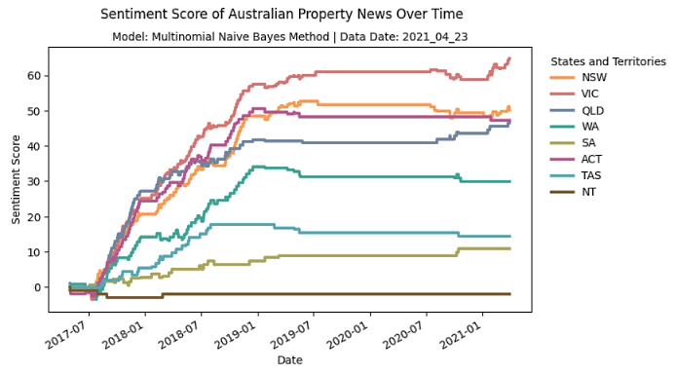
END DELIVERABLE
“Autonomously estimate the relative strengths of the property market across all states and territories in Australia, as a function of time”

Slide 10
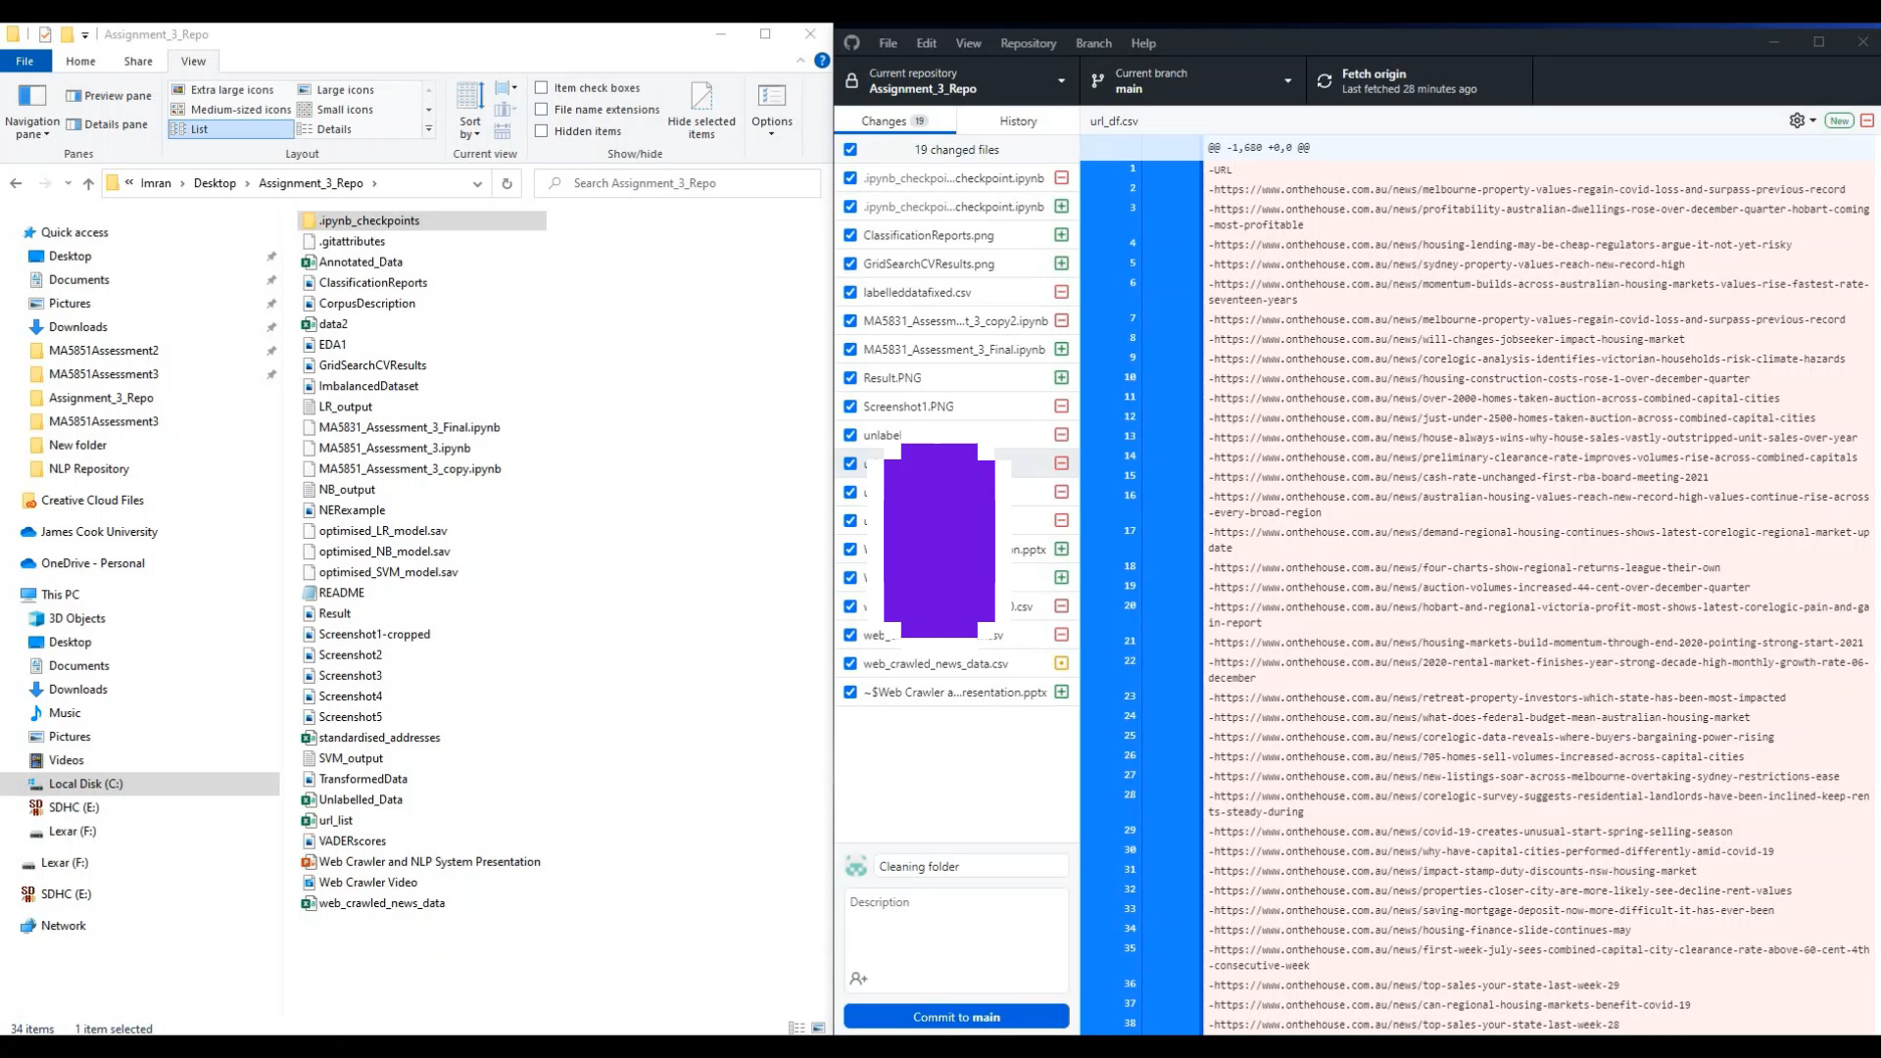
DEMONSTRATION OF GITHUB REPOSITORY

Slide 11
LIMITATIONS DISCUSSION
STAGE | LIMITATION | DISCUSSION
Web Crawler | DOM Changes | Targeted HTML elements can be modified over time
 | Permitted Guidelines | Restricts the content that can be extracted
 | Place Tags | Place tags missing
NER | Generic Model Used | Model was not fine-tuned due to time constraints
 | Resource Availability | Requires 16GB GPU memory for BERT
Sentiment Analysis | Annotated Data | Label more than 500 records to re-train classifiers
 | Resource Availability | Requires 16GB GPU memory for BERT
 | Missing Aspects | Aspect sentiment analysis for greater insight

Slide 12
THANKS FOR LISTENING

